Slide 1




14,15,21,22 November 2015

Slide 2

Day 3 – Preprocessing
Outlines
Review
Stemming and Normalization
A little about Naïve Bayes

Slide 3
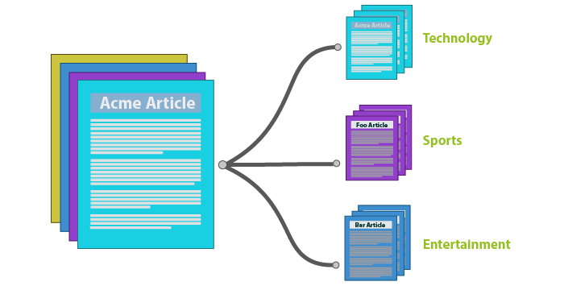
Text Classification – Our Task
Article Categorization
Medical related
Technology
Politics
Crimes
Sports
Supervised Machine Learning
Naïve Bayes

Slide 4
Regular Expression
Regex
a sequence of characters that define a search pattern
mainly for use in pattern matching with strings, or string matching

Slide 5
Preprocessing
Case Folding
Remove URL and other non-alphabetic symbol
Normalize non-standard words
number to letter → 4wes0m3
symbol to letter → @wesome
remove multiple letter → goooood
Tokenization
Stemming
Lemmatization
Stop word removal

Slide 6
Word Normalization
def preprocess (article): # case folding article = article.lower() # url removal article = removeUrl(article) # non alphabetic removal
article = re.sub(r'([a-z])-([a-z])', r'\1 \2', article) article = re.sub(r'[^a-z|^ ]', '', article) # tokenization tokens = article.split() # coming soon - stemming # stopword removal result = stopwordRemoval(tokens) return result

Slide 7
Word Morphology
Morphemes
The small meaningful units that makes up the word
Stems : the core meaning-bearing units
Affixes : Bits and pieces that adhere to stems

Slide 8
Stemming
IR : Reduce terms to their stems
Crude chopping of affixes
Simplified version of Lemmatization
Porter’s Stemmer Algorithm
Martin Porter 1980 - English
Daniel O, Habib M, M Hafidz - Indonesia

Slide 9
Porter’s Stemmer for Indonesia
1st rule : remove particle
( -kah, -lah, -tah, -pun )
2nd rule : remove Possessive Pronoun
( -ku, -mu, -nya )
3rd rule : remove 1st Order of Derivational Prefix
( me-, pe-, di-, ter-, ke- )
4th rule : remove 2nd Order of Derivational Prefix
( be-, pe- )
5th rule : remove Derivational Suffix
( -kan, -an, -i )

Slide 10
Porter’s Stemmer for Indonesia
word
Remove Particle
Remove Possessive Pronoun
Remove 1st Order Prefix
fail
A rule is fired
Remove 2nd Order Prefix
Remove Suffix
fail
A rule is fired
Remove Suffix
Remove 2nd Order Prefix
Stem result

Slide 11
Porter’s Stemmer for Indonesia
Algorithm
Remove particle (1st rule)
Remove possessive pronoun (2nd rule)
Remove 1st order prefix (3rd rule)
If no 1st order prefix found then
Remove 2nd order prefix (4th rule)
Remove suffix (5th rule)
Else (no 1st order prefix found)
Remove suffix (5th rule)
If any suffix found then
Remove 2nd order prefix (4th rule)

Slide 12
Problem with Stemming
Root word that looks like having suffix/prefix
Sekolah, masalah
Check each token to root word list before firing a rule
Memilah
By porter stemming it will become : me-mi-lah

Slide 13
Problem with Stemming
Words that have more than one possible basic words
Memasak → me-masak? mem-pasak?
What to check first?
me- or mem-
Each rule has ups and downs
Memanah → me-manah | mem-panah
Memasuki → me-masuk-i | mem-pasuk-i

Slide 14
Problem with Stemming
It’s not perfect, but it’s good enough for stemming
To stem the token into a perfect root word is the problem of Lemmatization

Slide 15
1st Rule – Remove Particle
Remove -kah, -lah, -tah, -pun
def firstRule(token):
# affix –kah token = re.sub(r'([a-z0-9]+)kah$', r'\1', token)
# affix -lah
token = re.sub(r'([a-z0-9]+)lah$', r'\1', token)
...
return token

Slide 16
1st Rule – Remove Particle
Exit 1st rule if any rule is fired
def firstRule(token):
# affix –kah if re.search('([a-z0-9]+)kah$',token): token = re.sub(r'([a-z0-9]+)kah$', r'\1', token) return token
...
return token

Slide 17
1st Rule – Remove Particle
(Complete)
def firstRule(token): # affix -kah if re.search('([a-z0-9]+)kah$',token): token = re.sub(r'([a-z0-9]+)kah$', r'\1', token) return token # affix -lah if re.search('([a-z0-9]+)lah$',token): token = re.sub(r'([a-z0-9]+)lah$', r'\1', token) return token
...
...
# affix -tah if re.search('([a-z0-9]+)tah$',token): token = re.sub(r'([a-z0-9]+)tah$', r'\1', token) return token # affix -pun if re.search('([a-z0-9]+)pun$',token): token = re.sub(r'([a-z0-9]+)pun$', r'\1', token) return token
return token

Slide 18
2nd Rule – Possessive Pronoun
(Complete)
Remove -nya, -ku, -mu
def secondRule(token): # affix -nya if re.search('([a-z0-9]+)nya$',token): token = re.sub(r'([a-z0-9]+)nya$', r'\1', token) return token # affix -ku if re.search('([a-z0-9]+)ku$',token): token = re.sub(r'([a-z0-9]+)ku$', r'\1', token) return token ...
... # affix -mu if re.search('([a-z0-9]+)mu$',token): token = re.sub(r'([a-z0-9]+)mu$', r'\1', token) return token
return token

Slide 19
3rd Rule – 1st Order Prefix
(1)
Remove me- ( meng-, meny- )
def thirdRule(token):
# affix meng- if re.search('^meng',token): token = re.sub('^meng', '', token) return token # affix meny- if re.search('^meny',token): token = re.sub('^meny', 's', token) return token
...

Slide 20
3rd Rule – 1st Order Prefix
(2)
Remove me- ( men-, me-, mem- )
...
# affix men- if re.search('^men',token): token = re.sub('^men', '', token) return token
# affix me- if re.search('^me',token): token = re.sub('^me', '', token) if re.search('^m([^aiueo])',token): token = re.sub('^m([^aiueo])',r'\1',token) return token
...

Slide 21
3rd Rule – 1st Order Prefix
(3)
Remove pe- ( peng-, peny- )
...
# affix peng- if re.search('^peng',token): token = re.sub('^peng', '', token) return token # affix peny- if re.search('^peny',token): token = re.sub('^peny', 's', token) return token
...

Slide 22
3rd Rule – 1st Order Prefix
(4)
Remove pe- ( pen-, pem- )
...
# affix pen- if re.search('^pen',token): token = re.sub('^pen', '', token) return token # affix pem- if re.search('^pem',token): if re.search('^pem[aiueo]',token): token = re.sub('^pem', 'p', token) else: token = re.sub('^pem', '', token) return token
...

Slide 23
3rd Rule – 1st Order Prefix
(5)
Remove di-, ter-, ke-
...
# affix di- if re.search('^di',token): token = re.sub('^di', '', token) return token # affix ter- if re.search('^ter',token): token = re.sub('^ter', '', token) return token # affix ke- if re.search('^ke',token): token = re.sub('^ke', '', token) return token return token

Slide 24
4th Rule – 2nd Order Prefix
(1)
Remove be- ( ber-, bel-, bek+er- )
def fourthRule(token):
# affix ber- if re.search('^ber',token): token = re.sub('^ber', '', token) return token # affix belajar if re.search('^belajar',token): token = re.sub('^belajar', 'ajar', token) return token # affix bek+er- if re.search('^bek+er',token): token = re.sub('^bek+er', 'ker', token) return token
...

Slide 25
4th Rule – 2nd Order Prefix
(2)
Remove pe- ( per-, pel-, pe- )
... # affix per- if re.search('^per',token): token = re.sub('^per', '', token) return token # affix pelajar if re.search('^pelajar',token): token = re.sub('^pelajar', 'ajar', token) return token # affix pe- if re.search('^pe',token): token = re.sub('^pe', '', token) return token return token

Slide 26
5th Rule – Remove Suffix
(Complete)
Remove -kan, -an, -i
def fifthRule(token): # affix -kan if re.search(r'([a-z0-9]+)kan$',token): token = re.sub(r'([a-z0-9]+)kan$', r'\1', token) return token # affix -an if re.search(r'([a-z0-9]+)an$',token): token = re.sub(r'([a-z0-9]+)an$', r'\1', token) return token # affix -i if re.search(r'([a-z0-9]+)i$',token): token = re.sub(r'([a-z0-9]+)i$', r'\1', token) return token return token

Slide 27
Porter’s Stemmer
def stemming(token, rootword): token = firstRule(token) token = secondRule(token) tempToken = token token = thirdRule(token)
...
...
if tempToken==token: token = fourthRule(token) token = fifthRule(token) else: temptoken2 = token token = fifthRule(token) if token != temptoken2: token = fourthRule(token) return token
if token in rootword: return token

Slide 28
Preprocess function
def preprocess (article): ...
# stemming rootword = [line.rstrip('\n') for line in open('dictionary/rootword.txt')] nonKataDasar = list(set(tokens) - set(rootword)) kataDasar = list(set(tokens) - set(nonKataDasar)) for i in range(0, len(nonKataDasar)): nonKataDasar[i] = stemming(nonKataDasar[i],rootword) tokens = list(set(nonKataDasar + kataDasar))
...
return result

Slide 29
Wrap it up
import xlrd import openpyxl def preprocessFile (filenameInput, filenamePreprocessed): fileTrain = xlrd.open_workbook(filenameInput) dataTrain = fileTrain.sheet_by_index(0) rowLen = dataTrain.nrows filePreprocessed = openpyxl.Workbook() dataPreprocessed = filePreprocessed.active for i in range(0, rowLen): data_i = dataTrain.cell(i,0).value class_i = dataTrain.cell(i, 1).value prep = preprocess(data_i) if prep: for i in range(0,len(prep)): dataPreprocessed.append([''.join(prep[i]), class_i]) filePreprocessed.save(filenamePreprocessed) return dataPreprocessed

Slide 30
Wrap it up
import Preprocessing inputData = 'Data Training.xlsx'
preprocessedData = "dataset_preprocessing.xlsx"
print "preprocess file" Preprocessing.preprocessFile(inputData, preprocessedData)

Slide 31
Naïve Bayes Classifier

Slide 32
Naïve Bayes Introduction
Simple (“naïve”) classification method based on Bayes Rule
Relies on very simple representation of Document
Bag of words

Slide 33
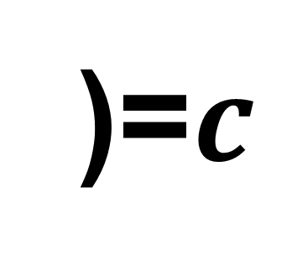
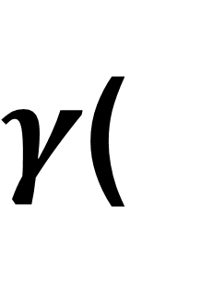
Bag of words
Masyarakat seharusnya tidak bisa membeli antibiotik secara bebas di apotek atau toko obat. Para tenaga kesehatan pun tidak boleh memberikan antibiotik kepada pasien yang sebenarnya tidak membutuhkan, misalnya, memberikan antibiotik untuk pasien yang sakit flu. Sebab, sakit flu disebabkan oleh infeksi virus, bukan bakteri, sehingga tidak perlu pemberian antibiotik.
$γ$(
)=$c$

Slide 34
Bag of words
Masyarakat seharusnya tidak bisa membeli antibiotik secara bebas di apotek atau toko obat. Para tenaga kesehatan pun tidak boleh memberikan antibiotik kepada pasien yang sebenarnya tidak membutuhkan, misalnya, memberikan antibiotik untuk pasien yang sakit flu. Sebab, sakit flu disebabkan oleh infeksi virus, bukan bakteri, sehingga tidak perlu pemberian antibiotik.
$γ$(
)=$c$

Slide 35
Bag of words
Masyarakat xxxxxxxxxx xxxxx xxxx xxxxxxx antibiotik xxxxxx xxxxx xx apotek xxxx xxxx obat xxxx xxxxxx kesehatan xxx xxxxx xxxxx xxxxxxxxxx antibiotik xxxxxx xxxxxx xxxx xxxxxxxxxx xxxxx xxxxxxxxxxx, xxxxxxxx, xxxxxxxxxx antibiotik xxxxx xxxxxx xxxx sakit flu. xxxxx, sakit flu xxxxxxxxxx xxxx infeksi virus, xxxxx bakteri, xxxxxxxx xxxxx xxxxx xxxxxxxxx antibiotik.
$γ$(
)=$c$

Slide 36
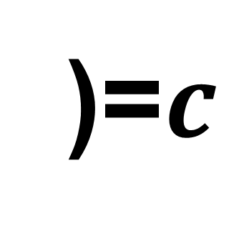
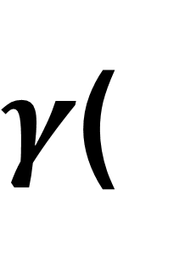
Bag of words
antibiotik | 4
flu | 2
sakit | 2
apotek | 1
bakteri | 1
… | …
$γ$(
)=$c$

Slide 37
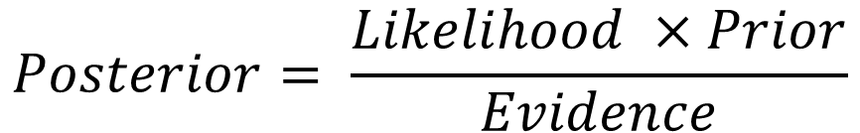
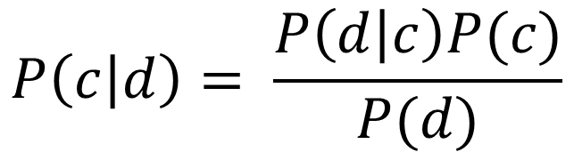
Bayesian Rule
For each document d and class c
$$P\left(c | d\right)= \frac{P\left(d | c\right)P(c)}{P(d)}$$
$$Posterior= \frac{Likelihood ×Prior}{Evidence}$$

Slide 38


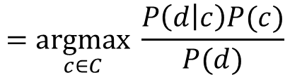

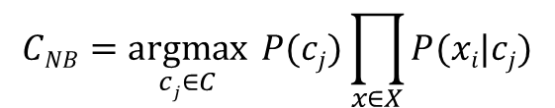

Bayesian Rule (Multinomial Naïve Bayes)
$$CMAP=\underset{c∈C}{argmax}{ P\left(c | d\right)}$$
$$CMAP=\underset{c∈C}{argmax}{ P\left(x1, x2, …, xn | c\right)P(c)}$$
$$=\underset{c∈C}{argmax}{ \frac{P\left(d | c\right)P(c)}{P(d)}}$$
$$CNB=\underset{cj∈C}{argmax}{ P(cj)\prod_{x∈X}{P(xi|cj)}}$$
$$=\underset{c∈C}{argmax}{ P\left(d | c\right)P(c)}$$
$$= max⁡(Likelihood ×Prior)$$

Slide 39
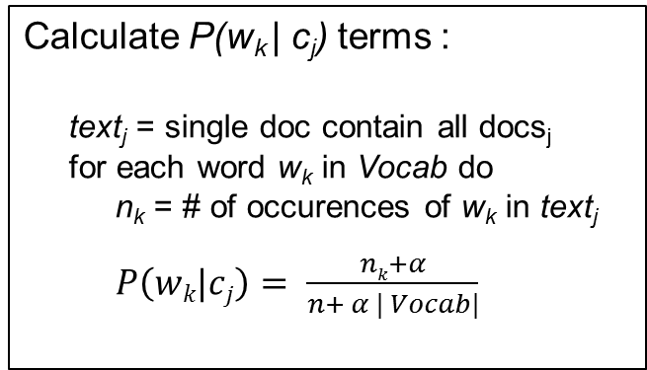
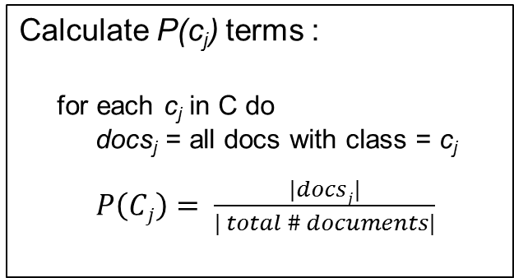
Multinomial Naïve Bayes - Learning
From training corpus, extract vocabulary for each class
Calculate P(c_{j}) terms :
for each c_{j} in C do
docs_{j} = all docs with class = c_{j}
$P\left(Cj\right)= \frac{|docsj|}{| total \# documents|}$
Calculate P(w_{k} | c_{j}) terms :
text_{j} = single doc contain all docs_{j}
for each word w_{k} in Vocab do
n_{k} = # of occurences of w_{k} in text_{j}
$P\left(wk|cj\right)= \frac{nk+α}{n+ α | Vocab|}$

Slide 40
Naïve Bayes Class
from __future__ import division from nltk.metrics import ConfusionMatrix import Preprocessing import openpyxl import xlrd
class NaiveBayes: def __init__(self, fileModel): self.fileModel = fileModel def learning(self, inputFile, featureFile): return
def testing(self, inputFile, outputFile):
return

Slide 41
THANK YOU

